Slide 1
Practical techniques in understanding of CI/CD.
Spring-Boot Application. From Dev to Deploy.
External training <EPAM> DevOps KhAI_Summer 2019.
made by: Rakivnenko Dmytro

Slide 2

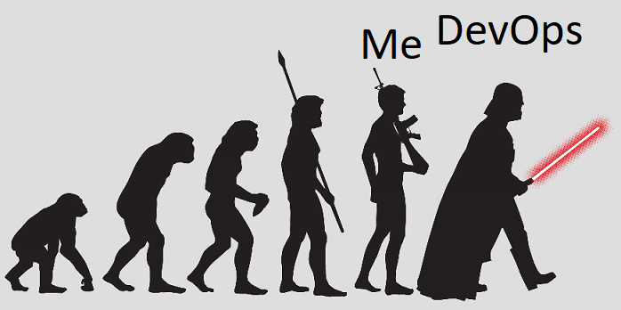

So. From the very beginning:
Expectation
I'm a Human - the top of evolution. Why should I do something, if the machine can do it.
And my job is to make this machine and control how it performs tasks for me.
Reality
It's me - when I have to do something.

Slide 3
As well as:
What does it need from me?
Stack of acquired knowledge
Little laziness
Persistence
PC with internet access
Terraform – Infrastructure as a code;
Ansible – PCA*;
AWS – Some Cloud provider;
Git – Version control;
Jenkins – Continuous integration;
Code – Product;
Tomcat – Web-Server.
*- Provisioning, Configuration management, and Application-deployment

Slide 4
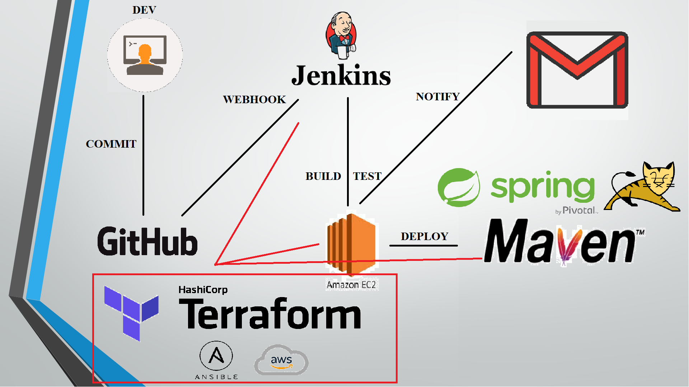
Project Structure

Slide 5
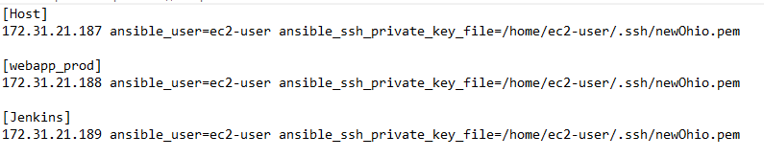
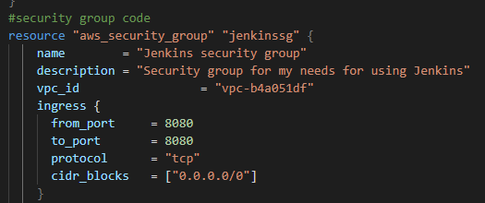
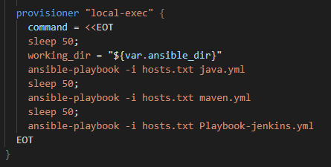
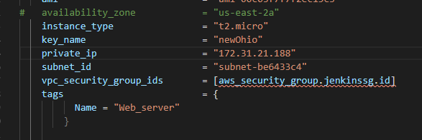
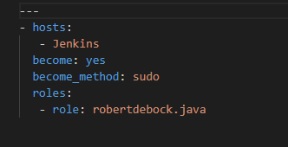
Infrastructure preparations:
Instance:
VPC
Security Group
OS Platform
Environment setting:
Build Requirements
CI/CD platform
Web Server

Slide 6
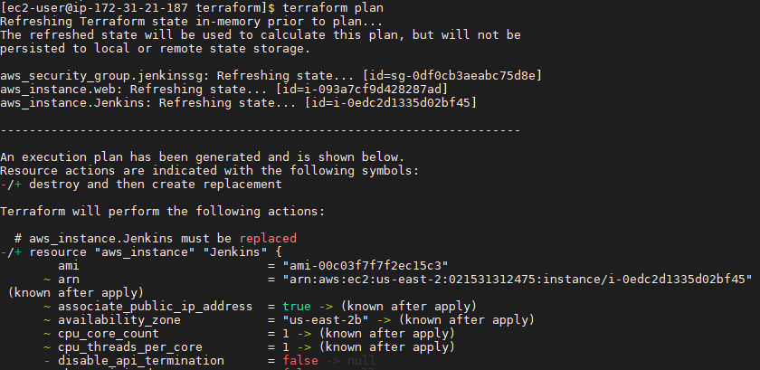
Waiting for deployment

Slide 7
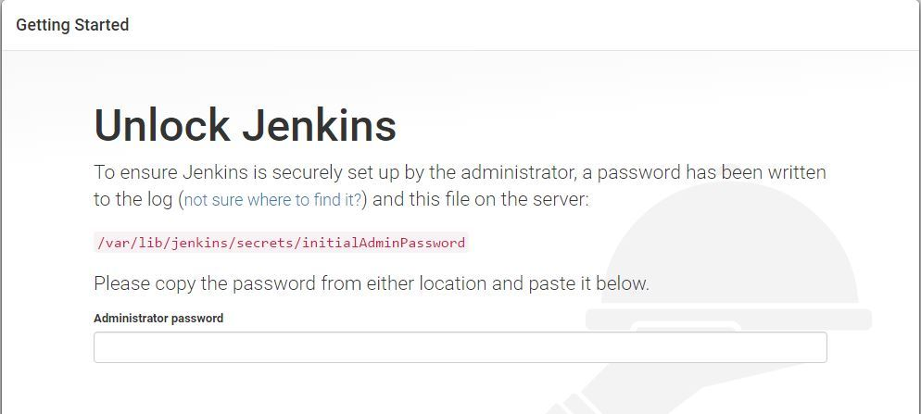
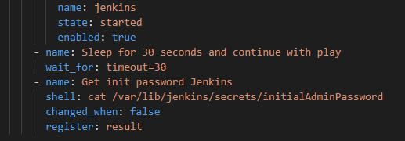
Login to Jenkins
The playbook that I have, by the end of the run, even displays PassPhrase for Jenkins.
If necessary, I also have a playbook for Jenkins-Node, which can be used to raise additional nodes without problems on which some work will be performed.

Slide 8
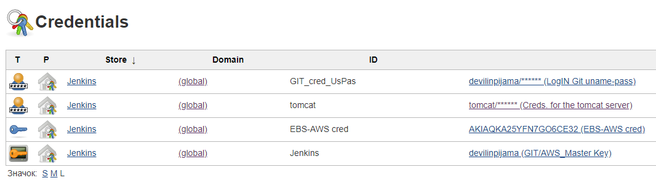
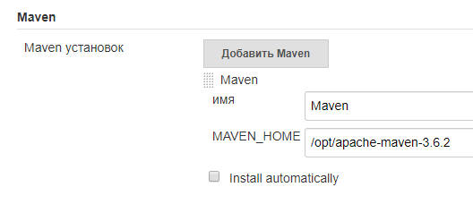
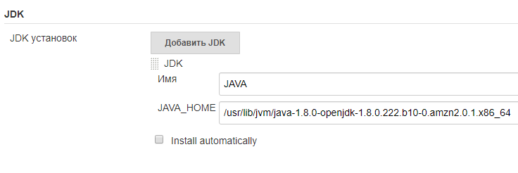
Setting Up Environment variables. And all credential.
The main advantage of deploying the environment through Ansible is that I do not need to go to the Jenkins Master machine, since all environment variables are set via Playbooks.
*Of course, it all went well, not the first time, but by the method of testing and mistakes, and some piece of patience.

Slide 9
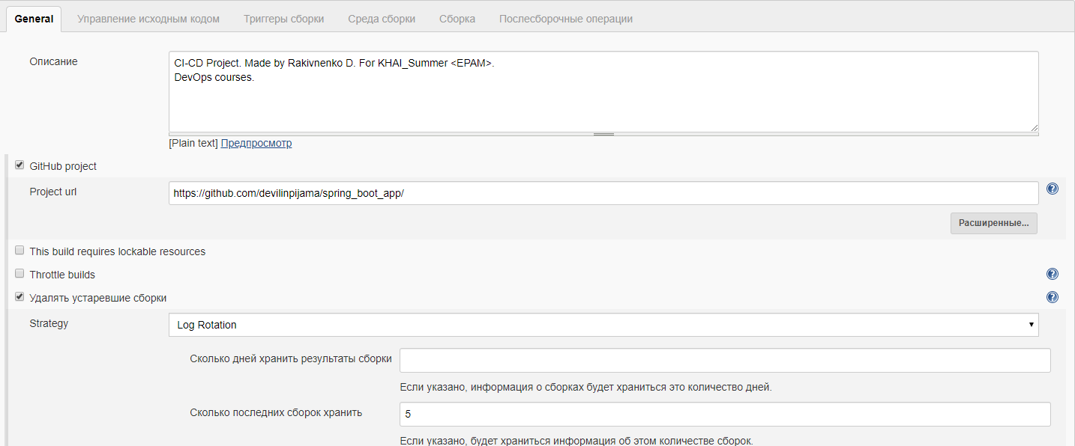
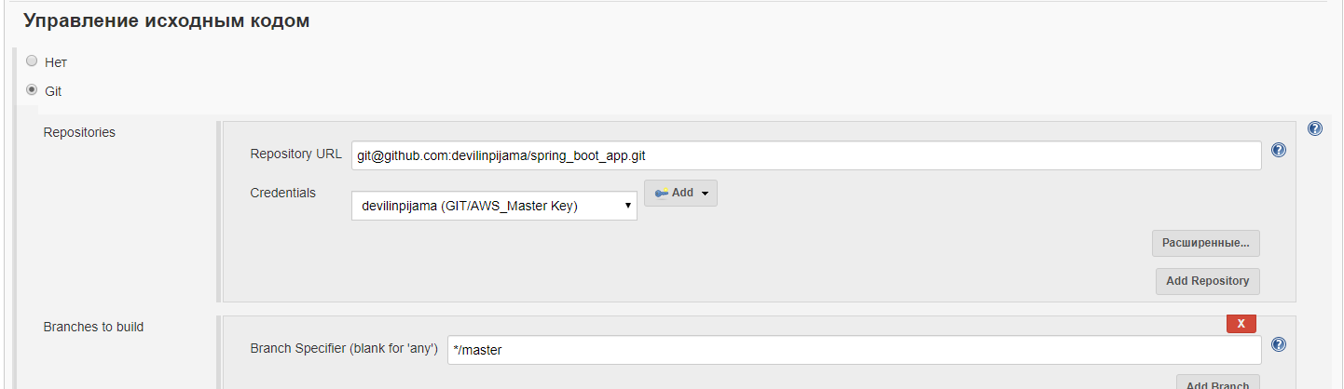
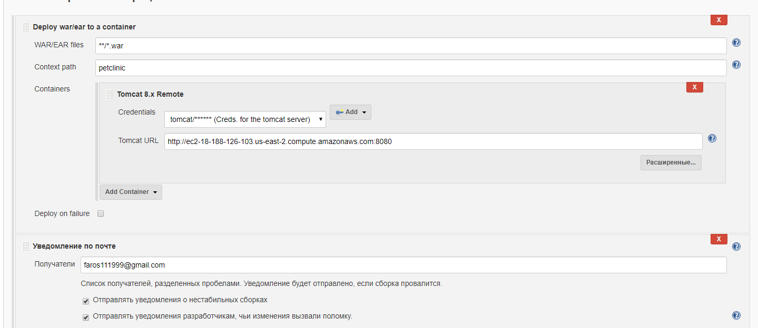
I’m create a Free-Style project. Configure everything necessary for build and deployment.
Github project.
Webhook.
Deployment.

Slide 10


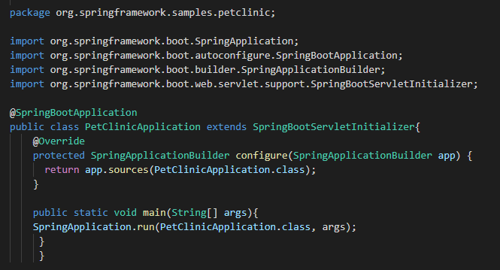
Application configuration:
It is also necessary to configure the code itself in order for the build to be made in .war format. One that can be deployed to tomcat without any problems. Since the source code is configured to build in .jar.
Pom.xml update
Petclinic.java updates

Slide 11
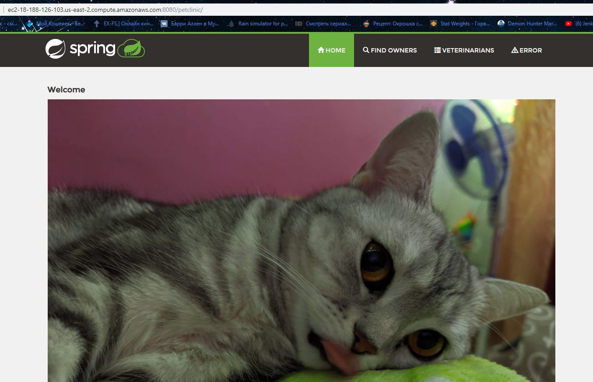
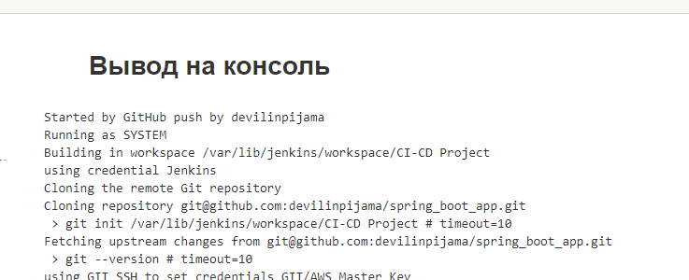
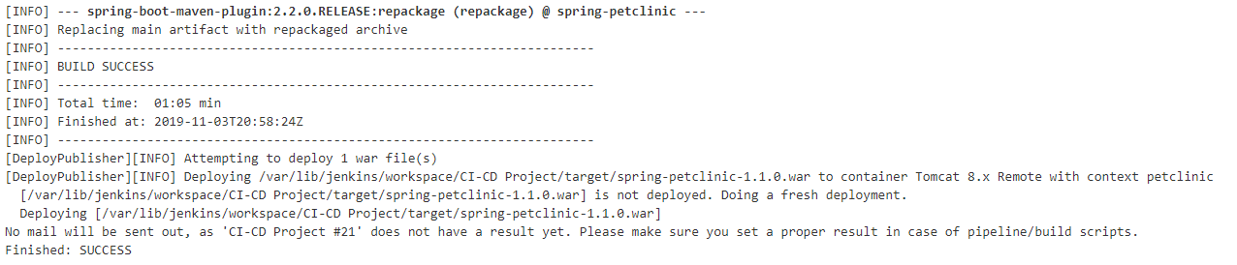
Build and Deploy.

Slide 12

Q&A session.

